Slide 1
Statistics for Analytics (BAN 100)
Assignment 5
by : Aaron Gonsalves
(161288196)

Slide 2
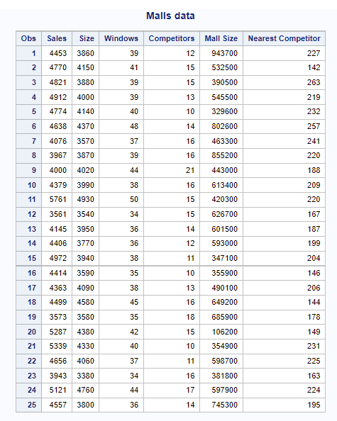
CODES
PROBLEM 1
proc import datafile='/home/u58712040/BAN100/files/malls.xlsx'
out=work.malls
dbms=xlsx
replace;
getnames=YES;
run;
title "Malls data";
proc print data=work.malls;
run;

Slide 3
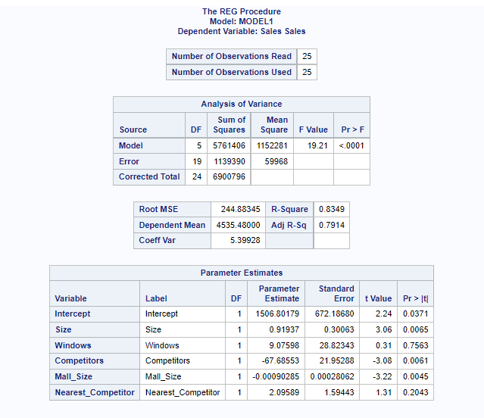
a) Multiple Regression model for the data
CODES
proc reg data=work.malls;
model sales = size windows competitors mall_size nearest_competitor;
run;

Slide 4
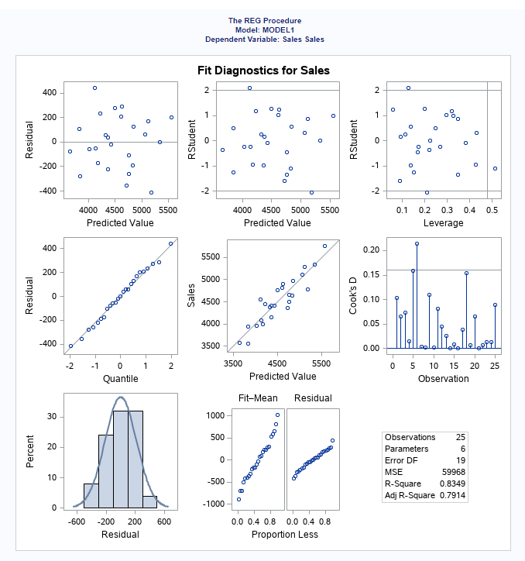
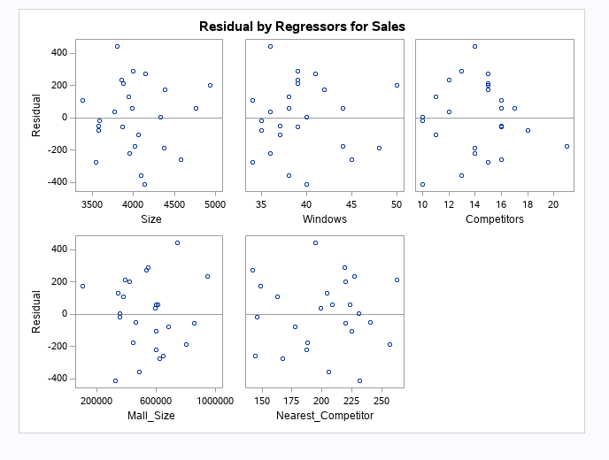

Slide 5
b) Interpret the values of the coefficients in the model.
Intercept value : 1506.80179
Regression co-efficient for size : 0.91937
Regression co-efficient for windows : 9.07598
Regression co-efficient for competitors : -67.68553
Regression co-efficient for mall size : -0.00090285
Regression co-efficient for nearest competitors : 2.09589

Slide 6
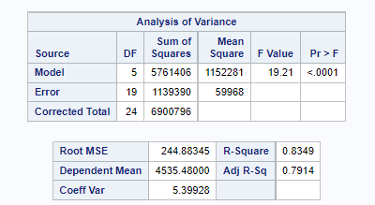
c) Test whether the model as a whole is significant. At the 0.05 level of significance, what is your conclusion?
Here, P –value is <.0001 which is less than 0.05
So, it can be concluded that the model as a whole is significant.

Slide 7
d) Use the model to predict monthly sales for each of the stores in the study.
CODES
proc reg data=work.malls;
model sales = size windows competitors mall_size nearest_competitor/r;
output out=temp cookd=cook student=studresids;
run;
proc sort data=temp;
by studresids;
run;
proc print data=temp;
run;

Slide 8
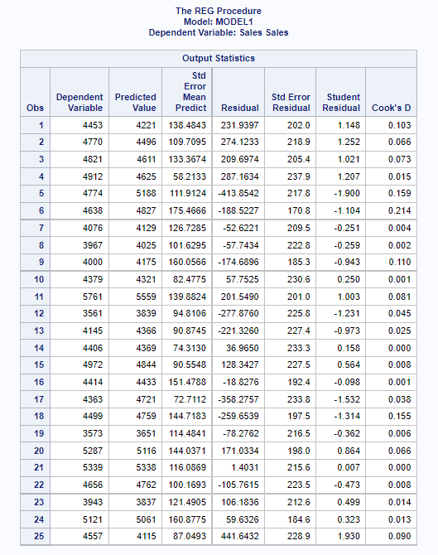
Predicting the variable sales from model
Sales is the dependent variable and its predicted value is shown in the adjacent column.
Predicted value of sales is mostly similar to actual given value.

Slide 9
e) Plot the residuals versus the actual values. Do you think that the model does a good job of predicting monthly sales? Why or why not?
Interpretation
Based on the residual plot, shown here, there is no systematic pattern, curve or trend for any of the variables.
It can be concluded that our model is a good fit and does a proper job in predicting monthly sales of each store.

Slide 10
f) Find and interpret the value of 𝑅² for this model.
R-Square value : 0.8349 i.e. 83.49%
As the R-squared value is > 80%, it is an accurate model and can be used for prediction.

Slide 11
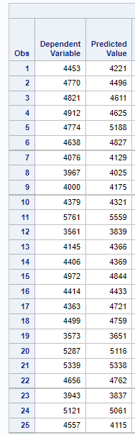
g) Do you think that this model will be useful in helping the planners? Why or why not?
Based on the shown table, the dependent variable, ‘sales’ and its predicted values are shown.
These values are almost same.
For any good model, predicted values should be near to actual values.
So, it can be concluded that this model will be useful in helping the planners.

Slide 12
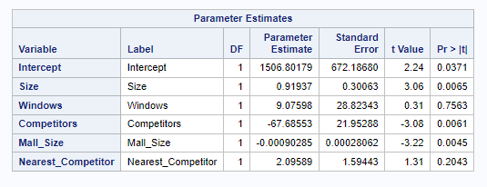
h) Test the individual regression coefficients. At the 0.05 level of significance, what are your conclusions?
Identifying the p-values for each variable from the regression model:
Size : 0.0065
Windows : 0.7563
Competitors : 0.0061
Mall_Size : 0.0045
Nearest_Competitor : 0.2043
Variables, ‘Windows’ and ‘Nearest Competitors’ have p-value > 0.05, so they are not significant.
Remaining variables are significant as they have p-value less than 0.05

Slide 13
i) If you were going to drop just one variable from the model, which one would you choose? Why?
If any variable is to be dropped by me, I would drop variable, ‘Windows’.
As from the model, p-value of variable ‘Windows’ is 0.7563(>0.05) which is very high.
Therefore, it is not significant in this model.

Slide 14
j) Use stepwise regression to find the best model for the data.
CODES
title "Forward, Backward and Stepwise Selection Methods
by using default values for SLENTRY and SLSTAY";
proc reg data=work.malls;
Forward:model sales = size windows competitors mall_size nearest_competitor /
selection = forward;
Backward:model sales = size windows competitors mall_size nearest_competitor /
selection = backward;
Stepwise:model sales = size windows competitors mall_size nearest_competitor /
selection = stepwise;
run;

Slide 15
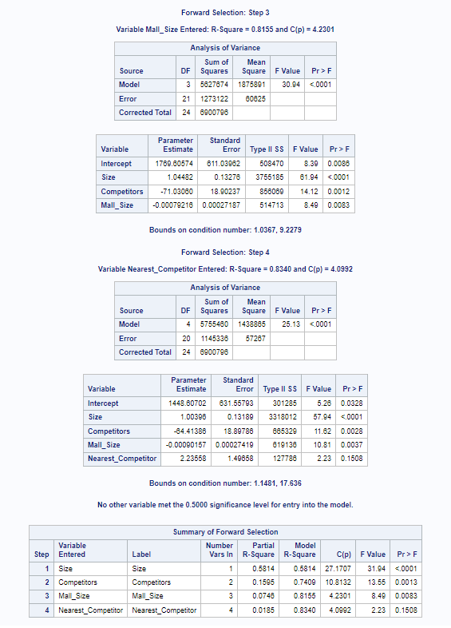
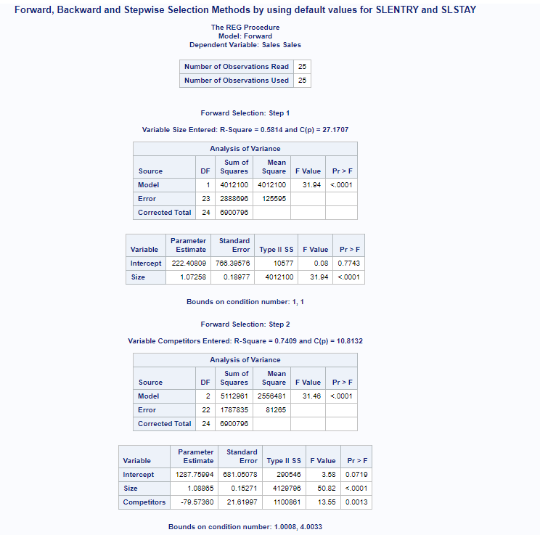
Forward selection

Slide 16
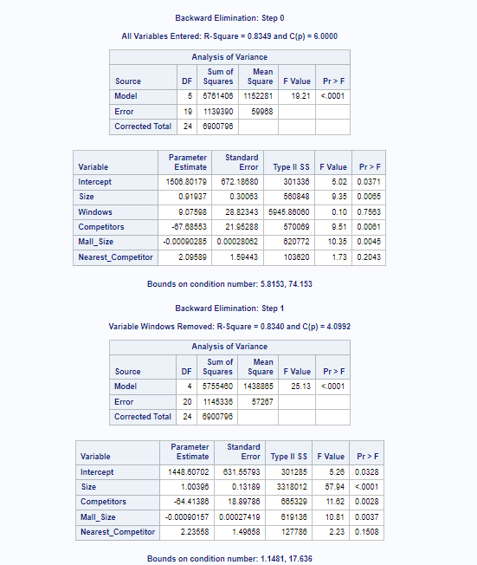
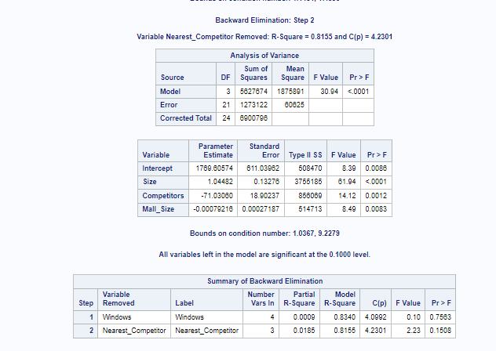
Backward Elimination

Slide 17
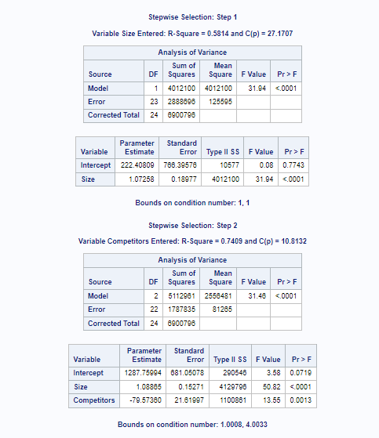
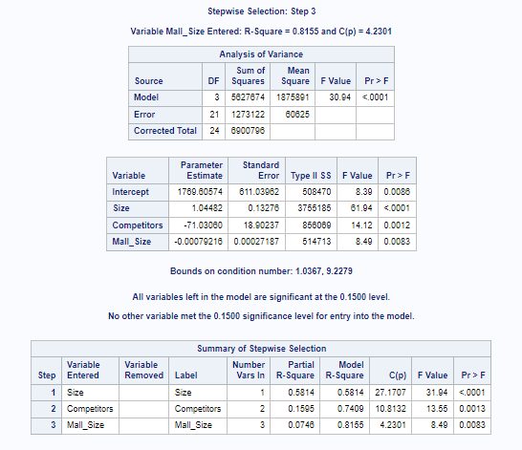
Stepwise selection

Slide 18
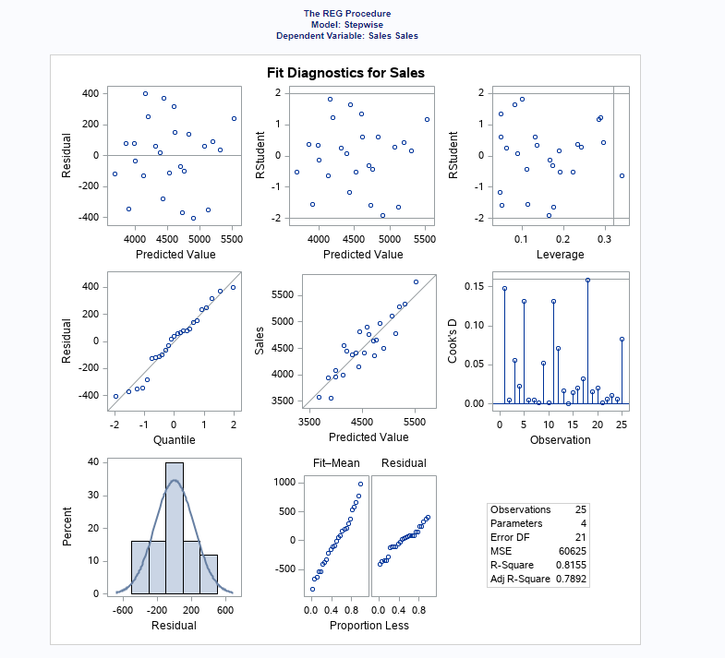
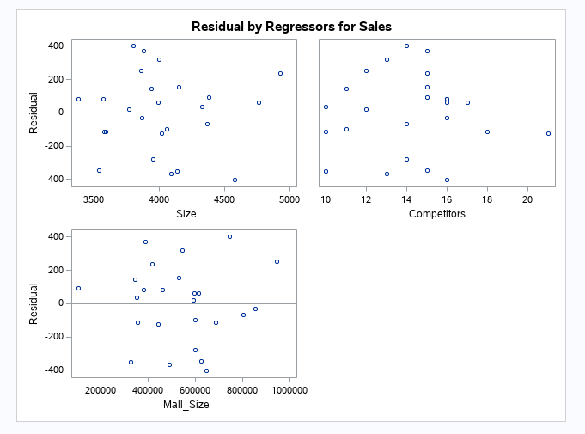

Slide 19
Interpretation
From all the performed selection methods, the best model for the data is the step wise selection model.

Slide 20
k) Analyze the model you have identified to determine whether it has any problems.
The model that I have chosen is stepwise selection model, where the final variables in this model are size, competitors and mall_size.
R-square value : 81.55%
All the variables that are in the model are significant at 0.1500 level.
Stepwise regression frequently gives many potential predictor variables but has very little data for estimation of coefficients meaningfully. So adding more data does not contribute.
Out of 2 predictor variables, only one of them may be in the model if both of them are highly correlated.

Slide 21
l) Write a memo reporting your findings to your boss. Identify the strengths and weaknesses of the model you have chosen.
Findings:
Out of 3 models utilized here, stepwise selection model is the best.
From selected model, the variables mall_size, size and competitors have the highest R-squared value, and these variables have the most impact on sales.
Predicted value of sales is almost same as the actual value of it.
Regression plots of these variables don’t have any pattern, trend or curve.
Therefore, this model is the best fit for prediction of sales.

Slide 22
Strengths:
Can manage large amounts of potential predictor variables by tweaking the model accordingly to choose best predictor variables from available options.
Faster than other automatic model-selection methods.
Useful information can be gathered about the quality of predictor variables by observing the order of addition and removal of variables.

Slide 23
Weaknesses:
Predicted values and confident intervals are very narrow.
R-squared values are generally very high.
Excessive collinearity will cause the program to discard predictor variables in the model.
Coefficients of other variables are very high and regression coefficients are biased.
If correlation between 2 predictor variables is high, only one of them may get in the model.

Slide 24
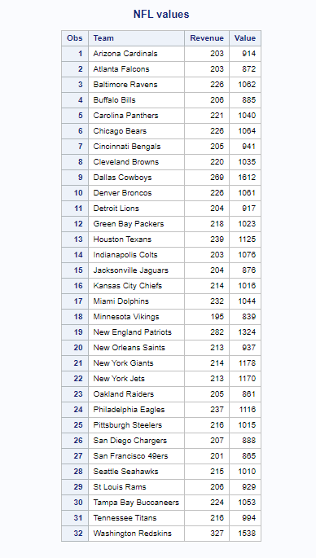
PROBLEM 2
CODES
proc import datafile='/home/u58712040/BAN100/files/NFLValues.xlsx'
out=work.nfl
dbms=xlsx
replace;
getnames=YES;
run;
title "NFL values";
proc print data=work.nfl;
run;

Slide 25
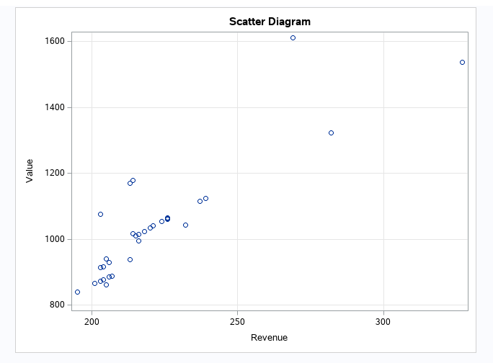
a) Develop a scatter diagram with Revenue on the horizontal axis and Value on the vertical axis. Does it appear that there are any outliers and/or influential observations in the data?
CODES
title "Scatter Diagram";
proc sgplot data=work.nfl;
scatter y = value x = Revenue;
xaxis grid;
yaxis grid;
run;

Slide 26
The scatter plot has outliers and influential observations in the data.
Some values in the graph are along the trend line, but others are away which are outliers.
Some outliers are influential observations as they don’t lie along the trend line.
Outliers are not always considered influential observations.
Influential observation refers to an observation, upon whose removal the estimation of regression coefficients drastically changes.

Slide 27
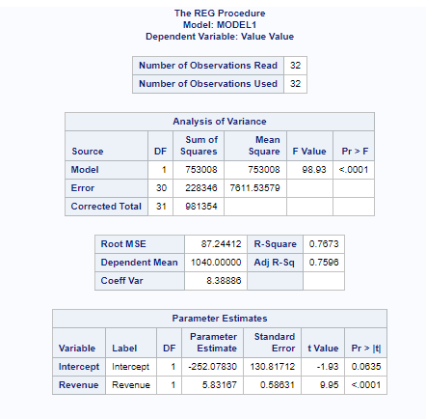
b) Develop the estimated regression equation that can be used to predict team value given the value of annual revenue.
CODES
proc reg data=work.nfl;
model value = revenue;
run;

Slide 28
Estimated Regression equation
Value = -252.0783 + 5.83167 * Revenue

Slide 29
c) Use residual analysis to determine whether any outliers and/or influential
observations are present. Briefly summarize your findings and conclusions.
CODES
proc reg data=work.nfl;
model Value = Revenue/r;
output out = temp cookd=cook student=studresids;
run;
proc sort data=temp;
by studresids;
run;
proc print data=temp;
run;

Slide 30
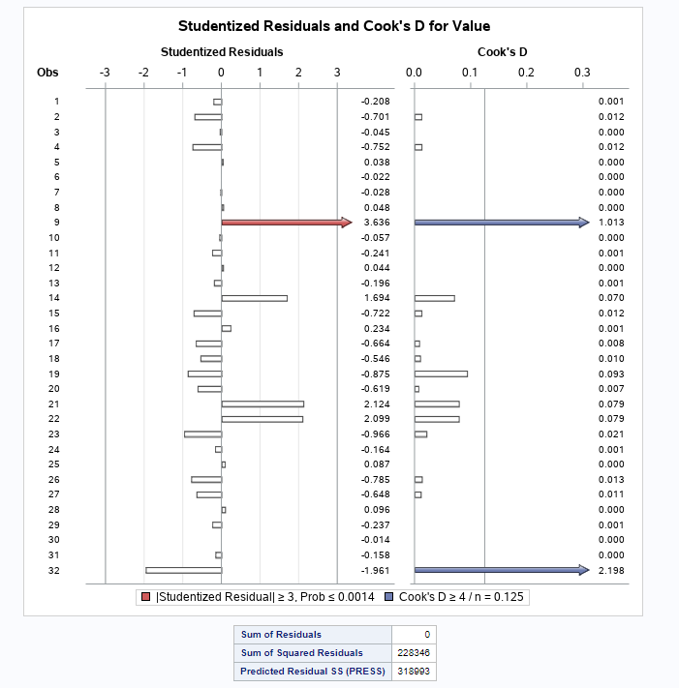
The red bar in the Studentized residual shows that it is an outlier, with a value >=3
The blue bar in Cook’s D graph, shows that those values are influential observations in the data.

Slide 31
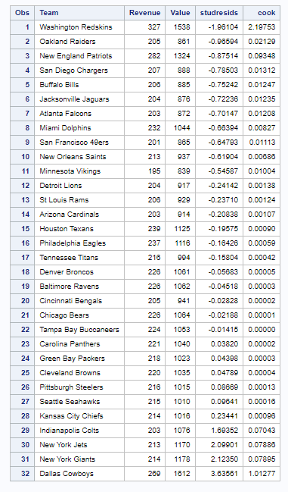
The value of studresids for the last observation listed here is 3.63561, which is >3 indicating that it is an outlier.
This was also shown in the previous output, by a red bar which displayed the outlier.

Slide 32
Findings and Conclusion
There is only one outlier and a couple of influential observations in the NFLValues dataset.
Based on the linear regression model, it is concluded that Team value depends on Revenue.

Slide 33
THANK YOU

